Slide 1




Offers – Lessons Learned
Annual Net Revenue Impact
Large
(>$5M)
Medium
($.5M-$5.0M)
Small
(<$.5M)
Negative
Key Takeaway | Offer Example | Net Revenue Impact
Free Offers drive incremental revenue when: - targeted to non/low VOD usage groups - directly related to VOD | First One On Us - Two distinct targets: 1. new installs 2. non/lapsed users
Mass Market Discount Offers drive incremental usage when: - They promote recent and high box office movies - They minimize BAU revenue cannibalization | FiOS Movie Night - $2 off 3 rentals every Friday night Movies >4 weeks into rental window After @70% of revenue curve
BOGO Offers do not drive enough incremental usage to offset cannibalization from BAU users | Order 3 Movies, get the 4th Free - In market 12/12- 3/13
Upgrade Offers drive smaller incremental revenue | Rent-to-Own - After viewing a rented movie, upgrade to own the movie for a reduced price

Slide 2
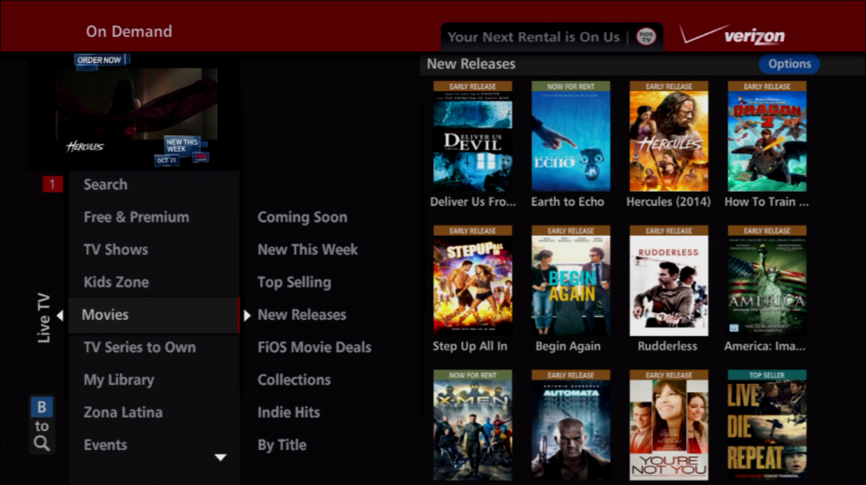
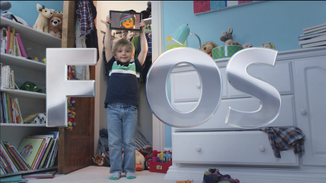


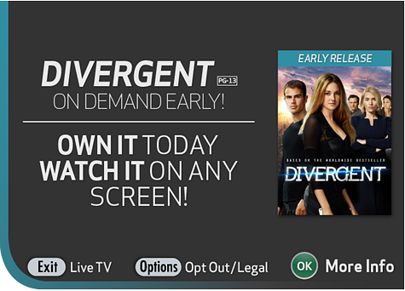
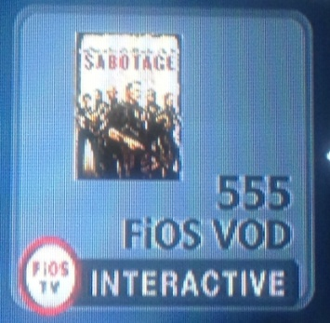
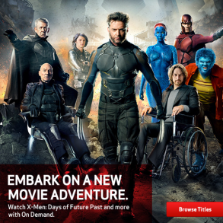
Tactics – Top 5
Annual Revenue Impact
Large
(>$5M)
Medium
($.5M-$5.0M)
Small
(<$.5M)
Key Tactic | Tactic Example | Key Metric | Revenue Impact
Curated Merchandising The VOD storefront is the most direct selling tactic | IMG Menu | Highest awareness of any VOD tactic (42%)
On Air Promotion VOD Cross Channel requires significant reach and frequency to drive constant awareness | EST/Mobility Spot | Second highest awareness among all tactics (38%)
Print Bi-monthly magazine works well as a movie reference guide | Spotlight Magazine | #1 tactic when awareness (36%) and usage impact (29%) is combined
IMG Tactics Work best when integrated into the user experience, or highly targeted | Guide Banner Targeted Splash Promo Channel | YTD Revenue: Promo Channels $3.1M Targeted Splash $1.7M Guide Banner $.8M
Email Dedicated and Spotlight emails highlight the most recent and compelling VOD titles | Dedicated Email | Dedicated Email 24.3% open rate vs. 22.3% VZ eCRM avg

Slide 3
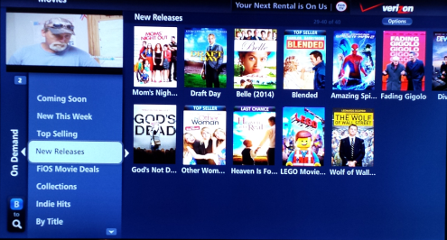
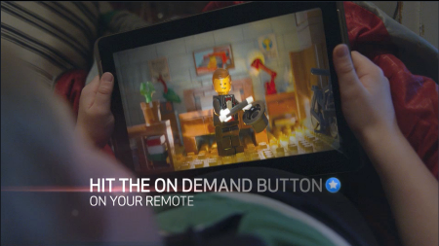
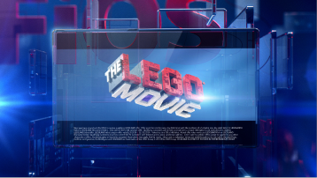
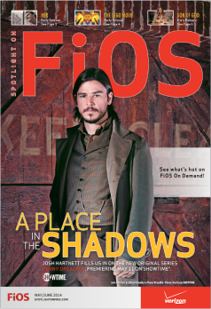

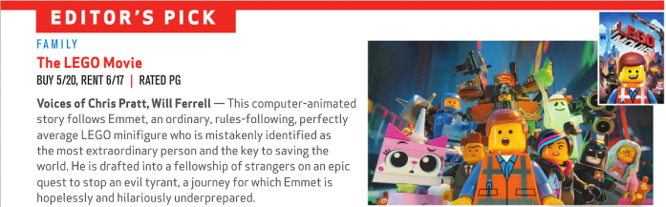
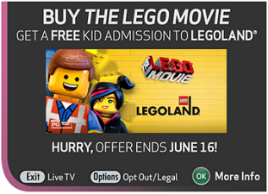
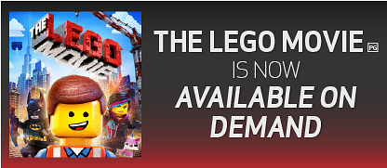
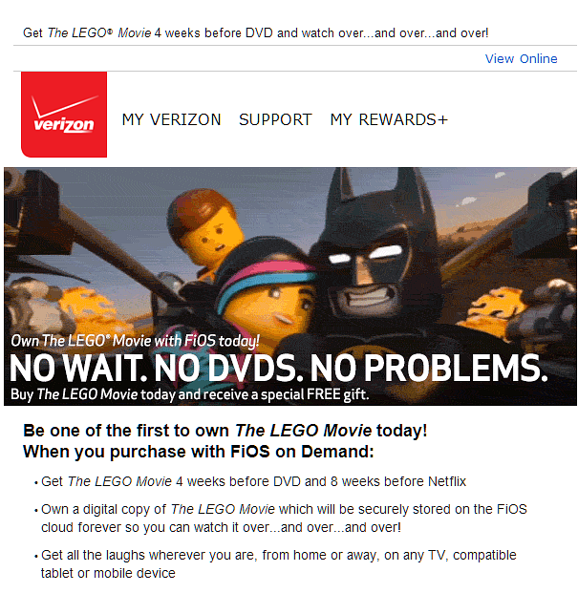
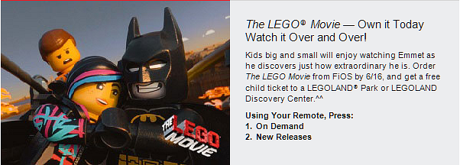
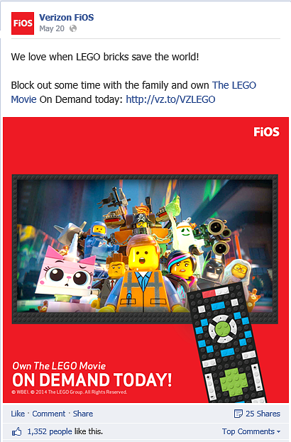
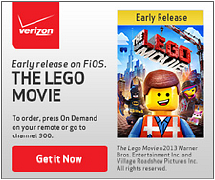

Tactic Execution Example
Key Tactic | Tactic Example
Curated Merchandising The VOD storefront is the most direct selling tactic | IMG Menu
On Air Promotion VOD Cross Channel requires significant reach and frequency | EST/Mobility Spot BAU Spot
Print Bi-monthly magazine works well as a movie reference guide | Spotlight Magazine
IMG Tactics Work best when integrated into user experience, or highly targeted | Targeted Splash Welcome Screen Pod Masthead & IMG Banner
Email Dedicated and Spotlight emails highlight the most recent and compelling VOD title | Dedicated Email & Spotlight Email
Other Social Media Online banners Free LEGOLAND ticket campaign | Social Media External Free Banner Ticket Offer
The Lego Movie
$3.0M revenue

Slide 4
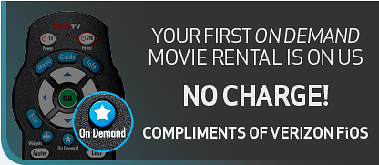


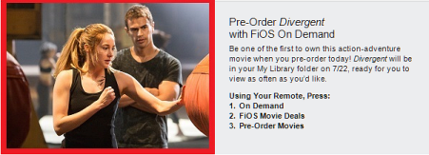
Offers
Net Revenue Impact
Large
(>$5M)
Medium
($.5M-$5.0M)
Small
(<$.5M)
Negative
Offer | Visual | Description | Impact | Key Metrics
First One On Us |  | Free VOD for customers who have never or not recently ordered a paid VOD . - 2 targets: new installs and lapsed users |  | Offer take rate 5% Subsequent paid usage rate of 31% Annual subsequent revenue of $22M Margin of $6.4M
Free VOD for Quality Problems |  | Free VOD proactively given to customers who experience a VOD functionality problem while watching. - Launched across footprint 7/29/14 |  | 17.5k qualifying customers so far 62% email open rate vs. 30% for avg eCRM marketing email 71% redemption rate vs. 5% for FOOU
Double Feature Discount |  | - Rent 1 movie, $1 off 2nd movie w/in 24 hrs - Buy 1 movie, $2 off 2nd movie w/in 24 hrs |  | Offer take rate of 4.2% rental, 4.1% purchase $.6M incremental revenue (8 months)
FiOS Movie Night |  | Reduced rental price of 3 new release movies from $5.99 HD / $4.99 SD to $3.99 HD / $2.99 HD every Friday night - Movies >4 weeks into rental window |  | Participants have 19.5 VOD transactions per year vs. 7.4 for non participants 7% of Friday transactions/ 4% of revenue $2.5M revenue YTD, of which 35% on average is incremental - $735k YTD direct
Family Weekend Sale |  | Reduced rental price of 3 kids/family movies from $5.99 HD / $4.99 SD to $3.99 HD / $2.99 SD every Saturday/Sunday - Includes New Releases and DTV Kids titles |  | 2% of Sat/Sun transactions/ 1% of revenue $1.2M revenue YTD; 35% incremental - $875k YTD
Buy 3/Get 1 Free |  | Buy 3 movies, get the 4th free each month. - In market December 2012 - March 2013 |  | Offer take rate of 13.9% $3.1M revenue but did not offset costs of the free transactions Free transactions exceeded paid due to cannibalization for BAU heavy users
EST Pre-Order |  | Pre-order copy of upcoming major new release - Movie appears in library on premiere date |  | $380k revenue 2014 YTD
Rent to Own |  | After viewing a rented movie, upgrade to own the movie for a reduced price |  | $867k revenue 2014 YTD 2.0% conversion on kids titles;1.2% non-kids
thru

Slide 5
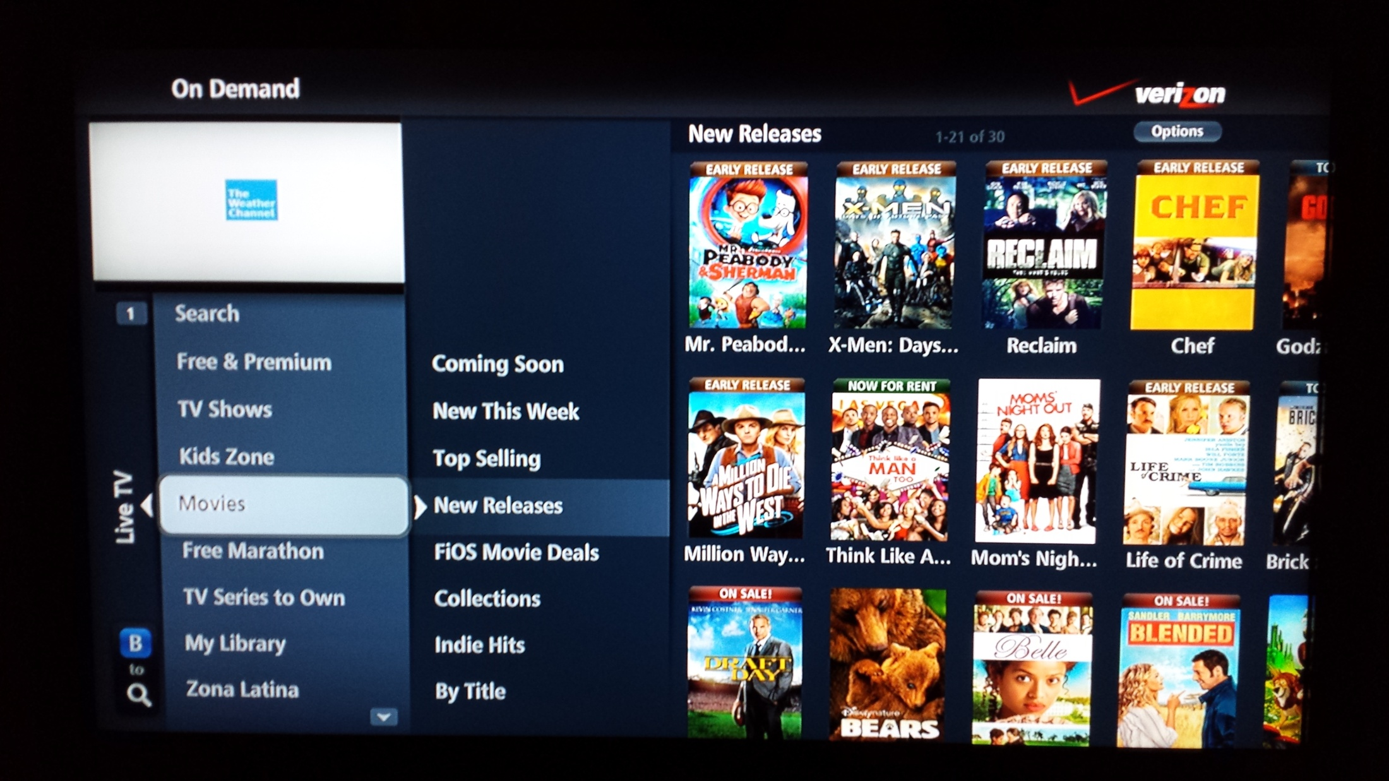

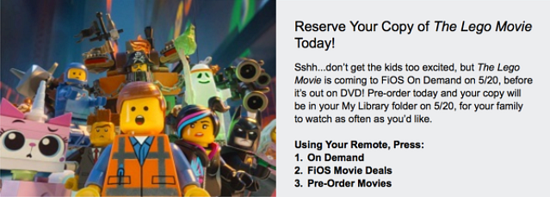
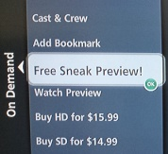
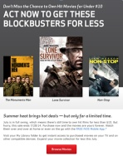
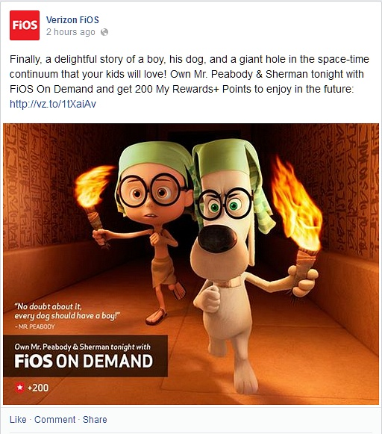
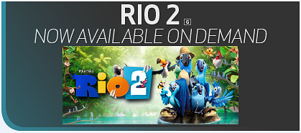

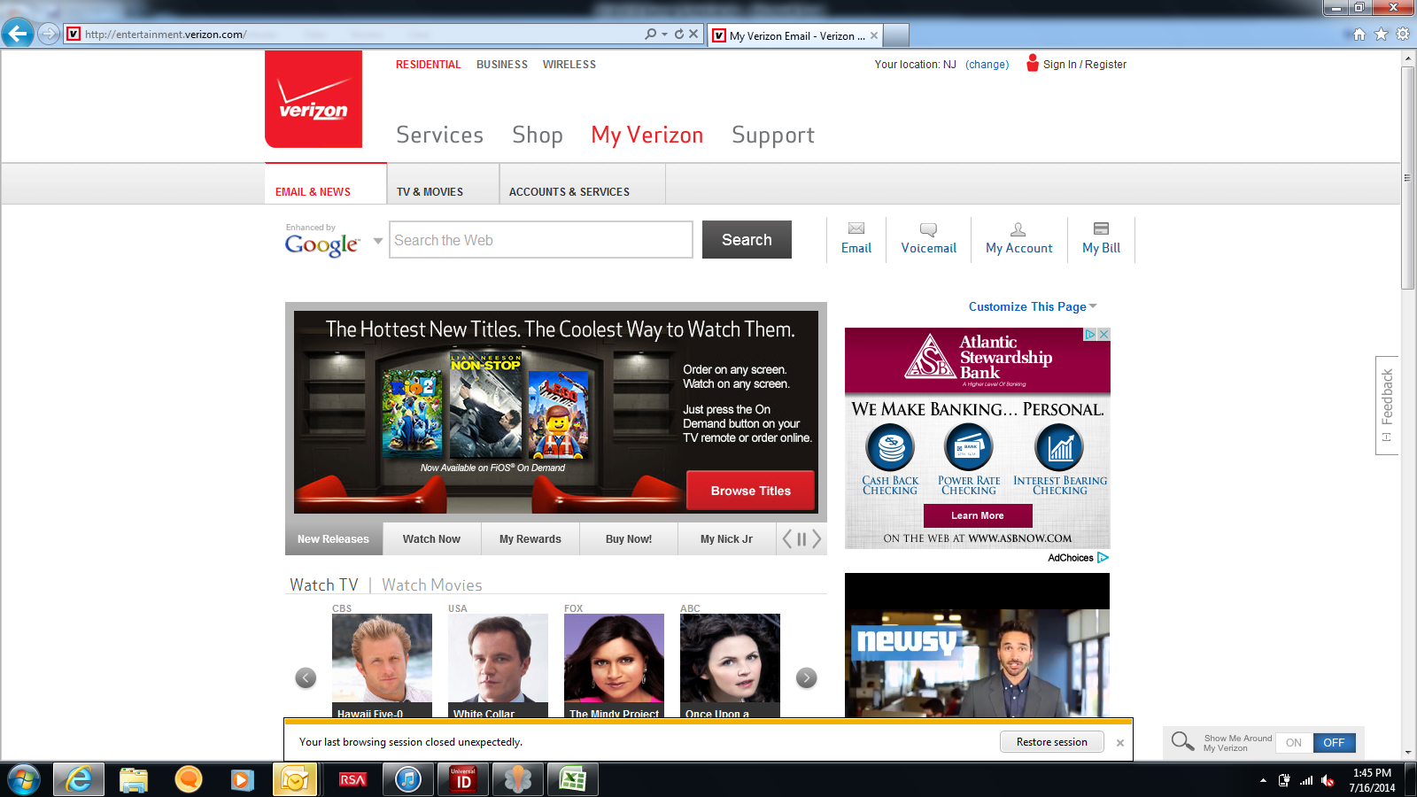
Tactics
Revenue Impact
Large
(>$5M)
Medium
($.5M-$5.0M)
Small
(<$.5M)
Tactic | Visual | Impact | Key Metric
On Demand Menu |  |  | Highest awareness of any VOD tactic (42%)
Spotlight Magazine |  |  | #1 tactic when awareness (36%) and usage impact (29%) is combined
Cross Channel |  |  | Second highest awareness among all tactics (38%) 40% minimum spot commitment of internal inventory
Spotlight Email |  |  | 19.2% open rate 0.5% CTR 2.8% CTO rate
Dedicated Email |  |  | 24.3% open rate vs. 22.3% VZ CRM avg 1.2% CTR 4.8% CTO rate
Welcome Screen |  |  | 30% awareness w/in 6 mos .2 % CTR vs .1% other pods 2-4% CTR for lingering pod 2% close rate of CTRs $327k revenue YTD
IMG Splash |  |  | 58% view rate 27k avg clicks; 2.6% CTR $25k avg revenue / splash $1.7M revenue YTD
Tactic | Visual | Impact | Key Metric
IMG Masthead |  |  | 5.4M impressions per masthead 0.3% CTR; 17k clicks / masthead 582 avg sales / $5.1k avg revenue $263K revenue YTD
IMG Guide Banner |  |  | 55M impressions per banner 0.06% CTR; 34k clicks per banner $16.5k avg revenue per banner $811k revenue YTD
Promo Channels in IMG Guide |  |  | $3.1M August YTD 3% of total revenue
Extended Preview |  |  | 27% conversion rate on extended previews, vs. 17% for short previews $4.1M revenue YTD
Social Media |  |  | 393k average reach 1.5k avg Likes, 21 Shares, 31 Comments, 144 .com clicks per promoted post
External Online Banner |  |  | 11M impressions per banner outside verizon.com 9k clicks per banner .08% CTR
Internal Online Banner |  |  | 43M impressions per banner w/in verizon.com 3k clicks per banner .01% CTR

